Slide 1


ecs36b Spring 2023: Software Development & Object-Oriented Programming #01: Object-Oriented Paradigm (1/2)
Abstraction
Encapsulation
Polymorphism
Inheritance
Dr. S. Felix Wu
sfwu@ucdavis.edu

Slide 2
Today…
What is Object-Oriented (OO)? And Why?
Basic OO Concepts
How to express those concepts in a particular Programming Language such as C++?

Slide 3
Object-Oriented Paradigm
Object-oriented analysis and modeling
Object-oriented design
Object-oriented programming
Object-oriented languages/constructs

Slide 4
From Wikipedia
Terminology invoking "objects" and "oriented" in the modern sense of object-oriented programming made its first appearance at MIT in the late 1950s and early 1960s. In the environment of the artificial intelligence group, as early as 1960, "object" could refer to identified items (LISP atoms) with properties (attributes);^{[3][4]} Alan Kay later cited a detailed understanding of LISP internals as a strong influence on his thinking in 1966.

Slide 5

Smalltalk is an object-oriented, dynamically typed reflective programming language. Smalltalk was created as the language underpinning the "new world" of computing exemplified by "human–computer symbiosis".

Slide 6
Why do ”we” want to learn OO??

Slide 7
Two sides of OO*
Better Software Development

Slide 8
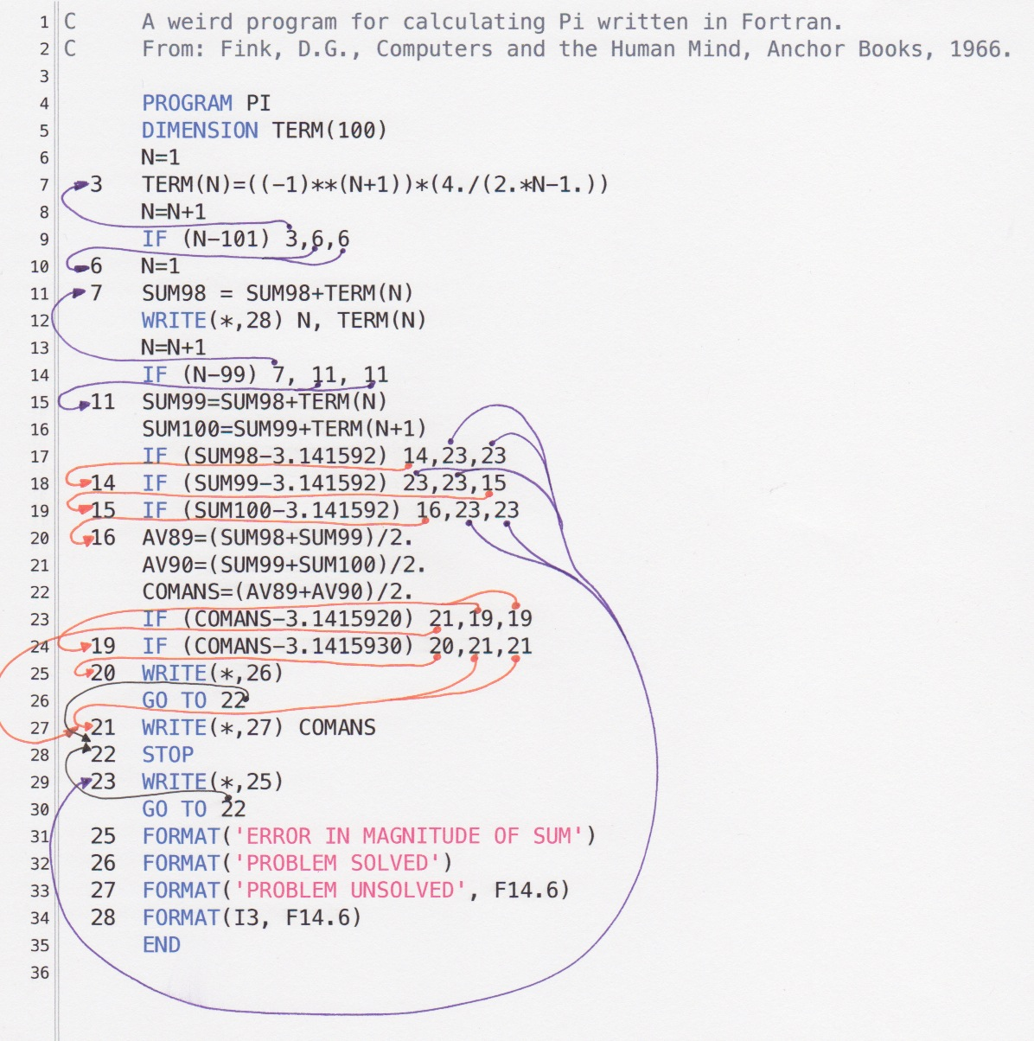
Two sides of OO*
Large program/system
Reusability
Debugging/Testing
Extensibility
…
BTW, C is a lot worse
“pointer”
Better Software Development

Slide 9
Function calls
Call by value
Call by reference/address
Call by name
int x;
fprintf(stderr, "%ld\n", (int)(&x));
printf("enter x\n");
scanf("%d", &x);
printf("%ld\n", (int) (*((int *) x)));
printf("%x\n", (int)(((char *) (&x)) + 1));
printf("%x\n, (int)(((char *) (&x + 1))));

Slide 10
Two sides of OO*
Large program/system
Reusability
Debugging/Testing
Extensibility
OO is/was our hope to dramatically enhance our chance in delivering high quality software in quantity
Better Software Development

Slide 11
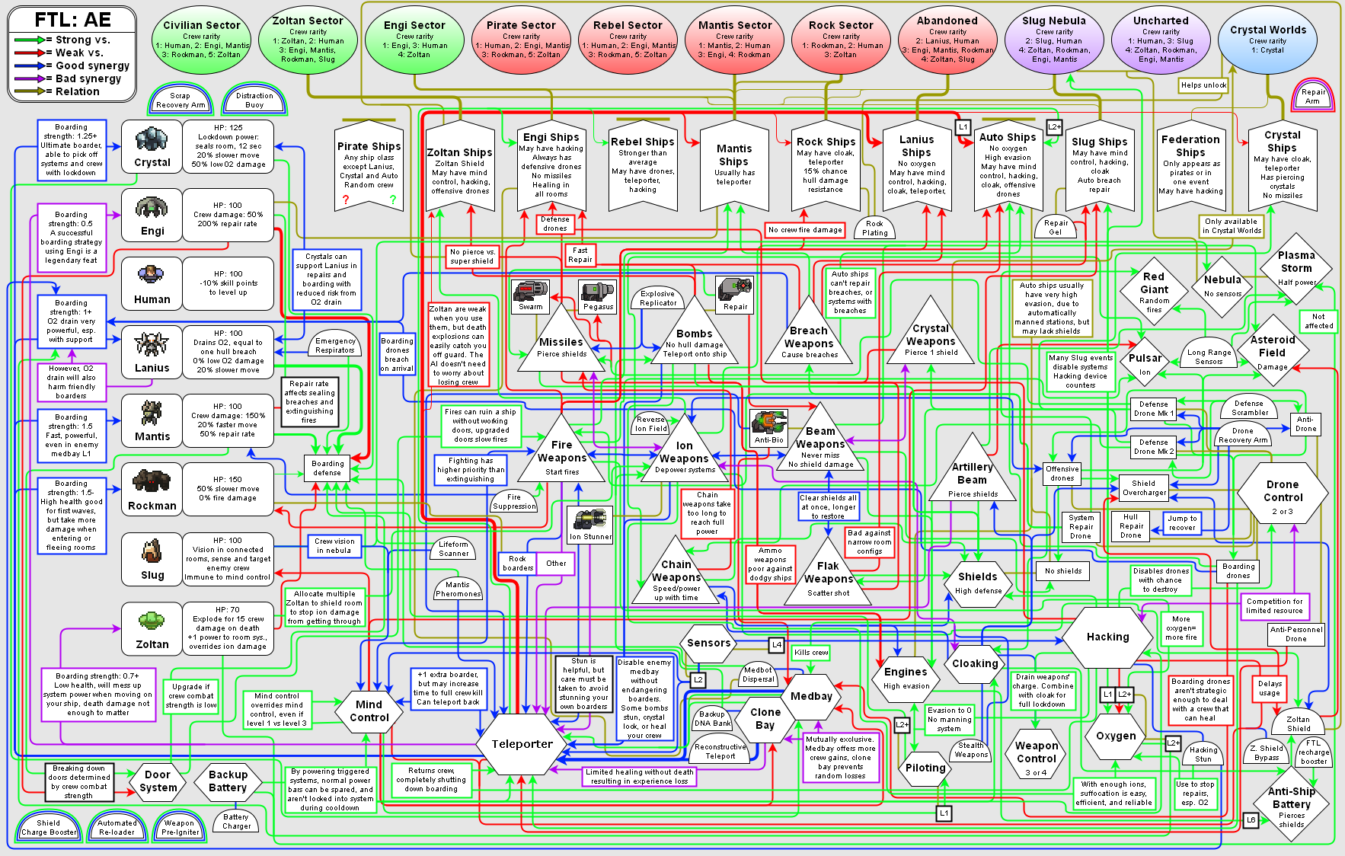
Two sides of OO*
Complexity of the Problem itself
Better Software Development

Slide 12
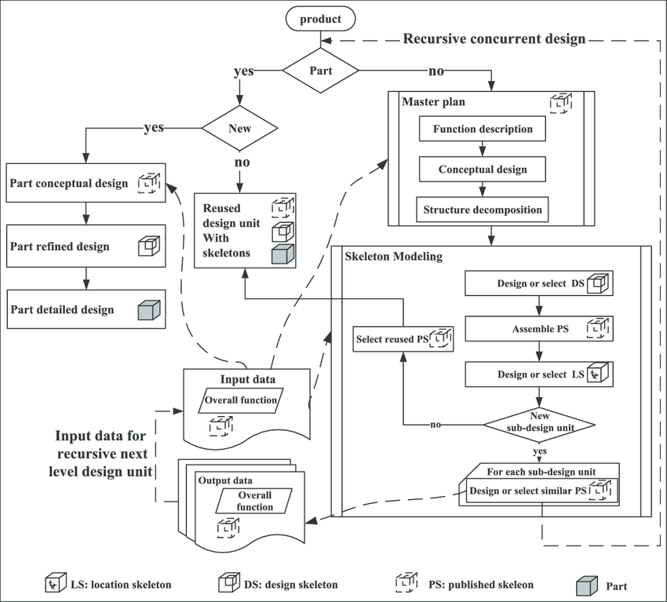
Control-Flow
driven
Data-driven
Data Abstraction
driven
Modeling the data naturally as what they really are and their semantic impacts

Slide 13
Two sides of OO*
Complexity of the Problem itself
Choosing the right-level of abstraction
Solving real problems!!
Better Software Development

Slide 14

Search Engine
Key words/Image/Voice ➔
Pointers/URLs to some Content

Slide 15
Search Engine
Key words/Image/Voice ➔
Pointers/URLs to some Content
Objects ➔
Objects

Slide 16
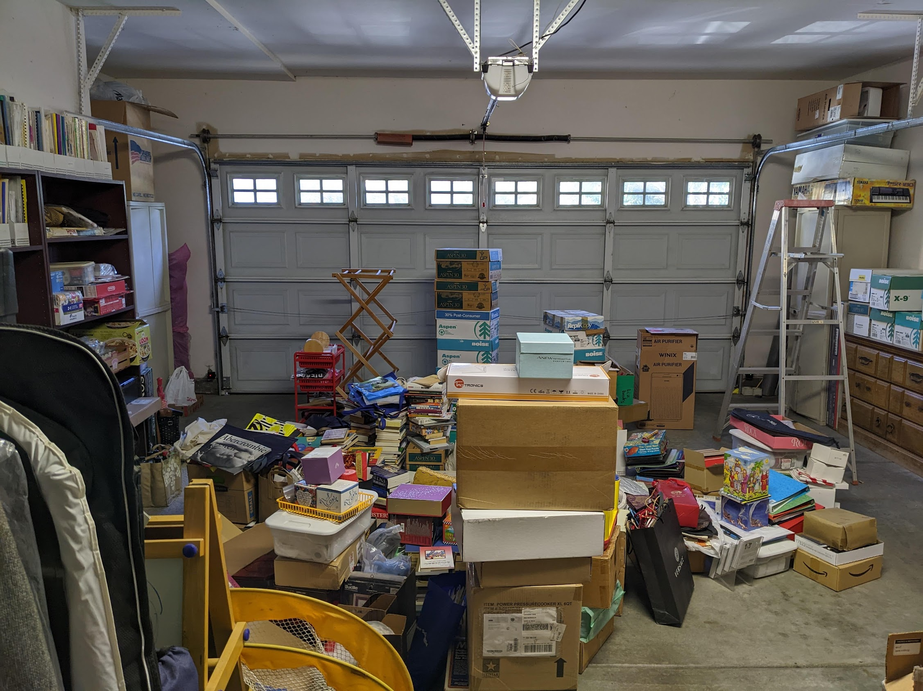

Slide 17
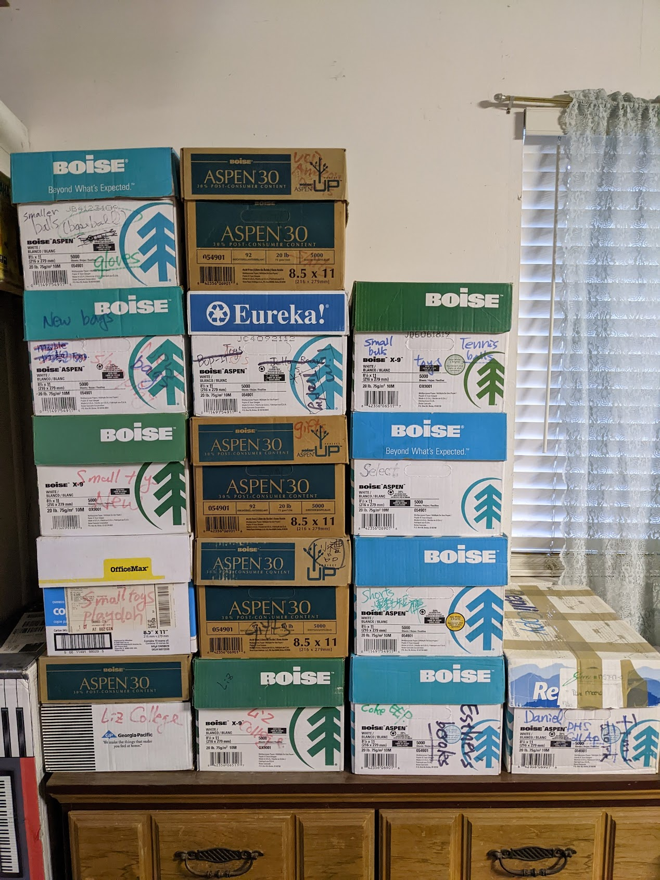

Slide 18
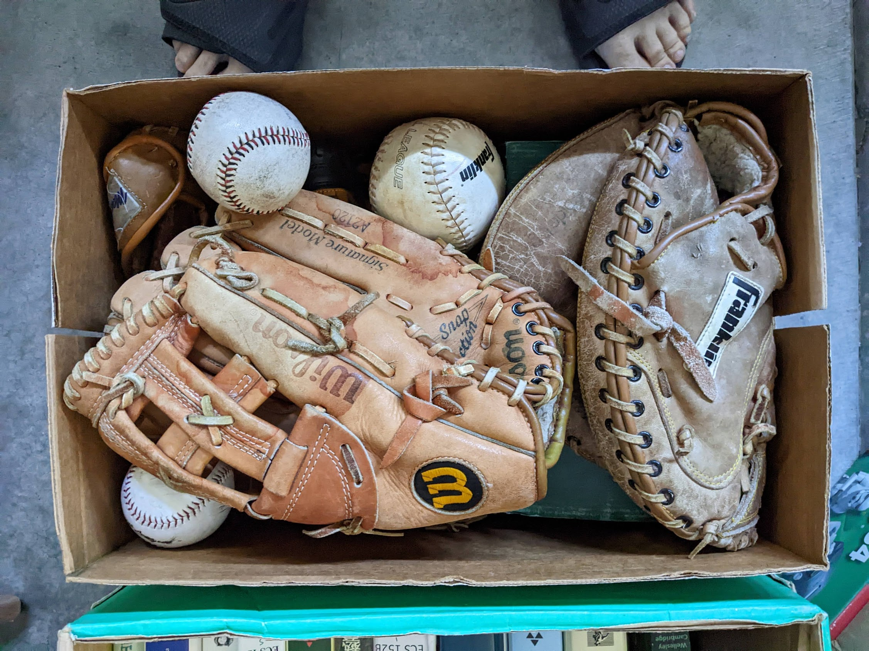

Slide 19
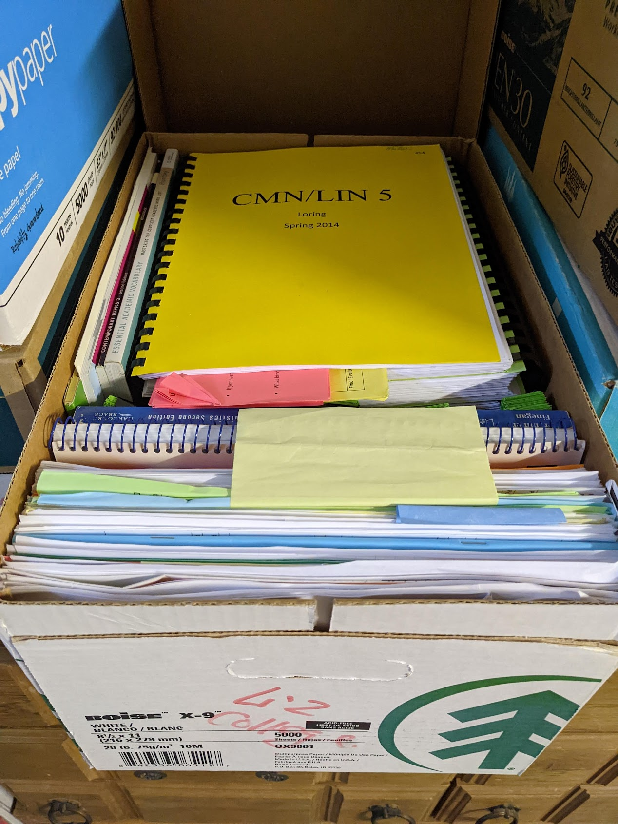

Slide 20
Search Engine
Objects from the pictures ➔
Boxes (another Objects) and Locations
People’s interactions with the Objects, when and where

Slide 21
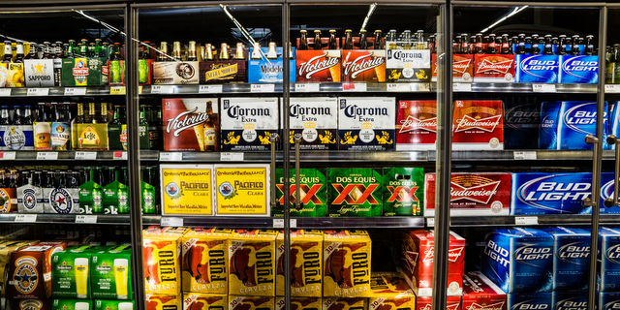
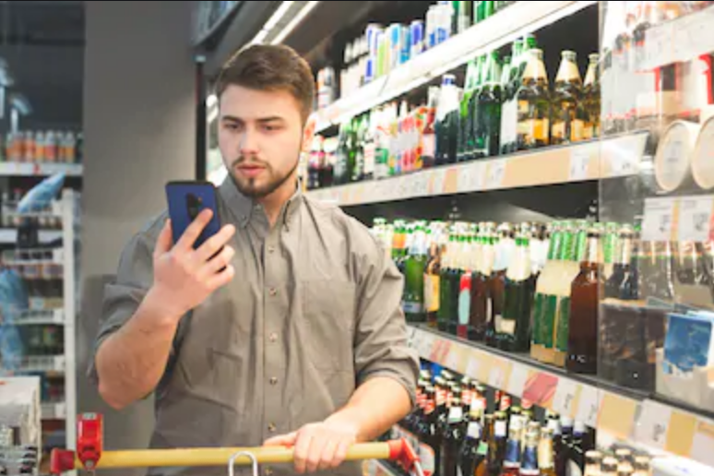
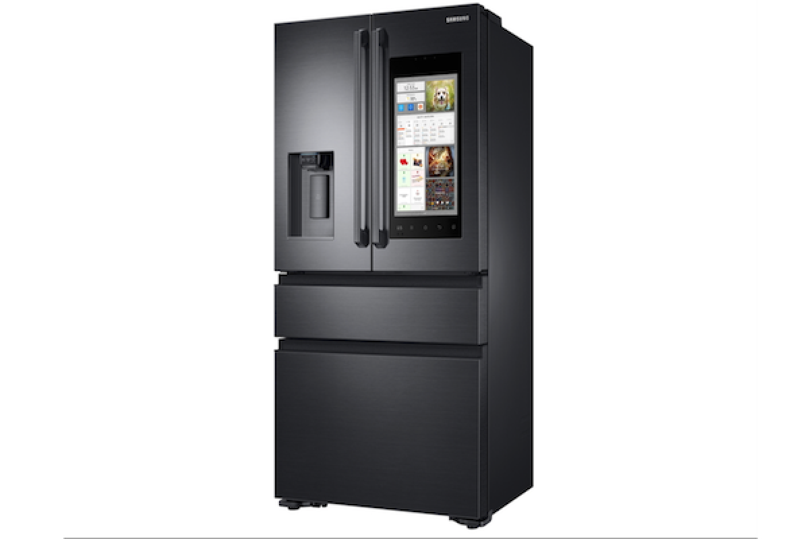
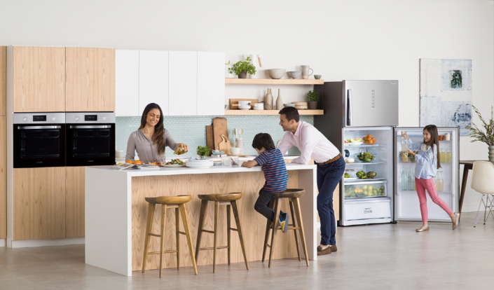
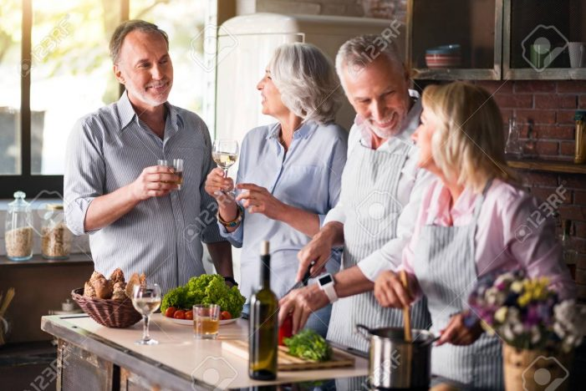
04/15/2022

Slide 22
Object-Oriented Programming
Syntax and Correctness
Object-Oriented Thinking
Innovative ways to advance our society

Slide 23
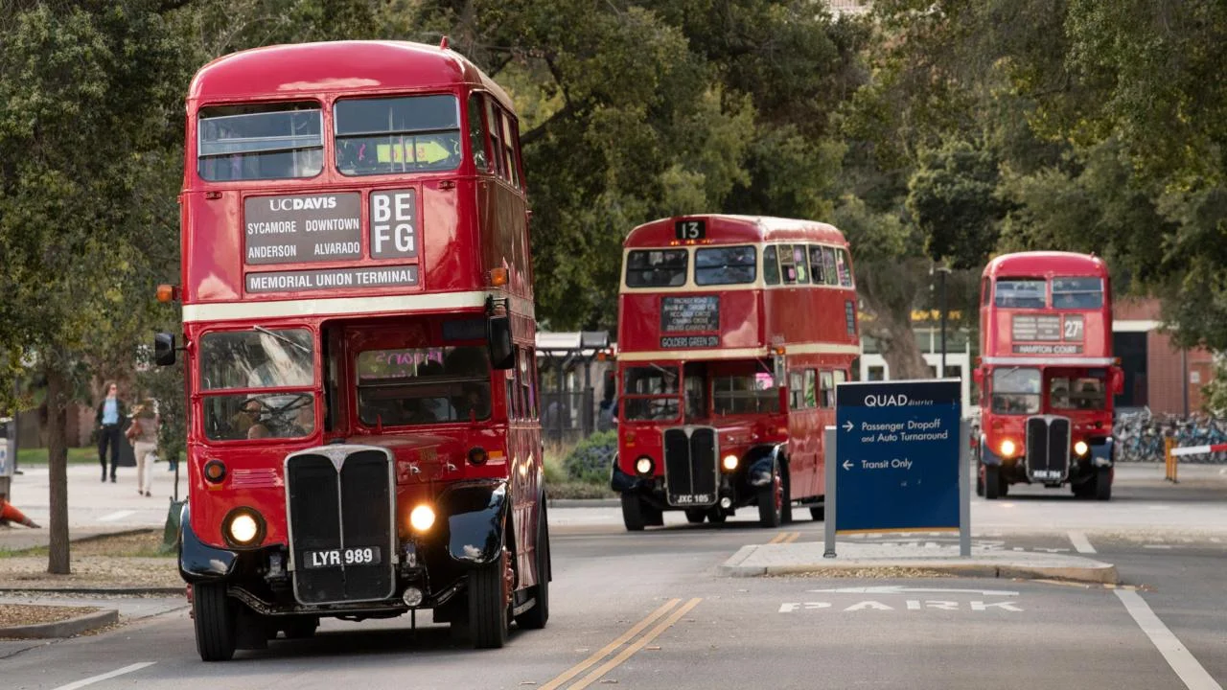
Spring 2023

Slide 24
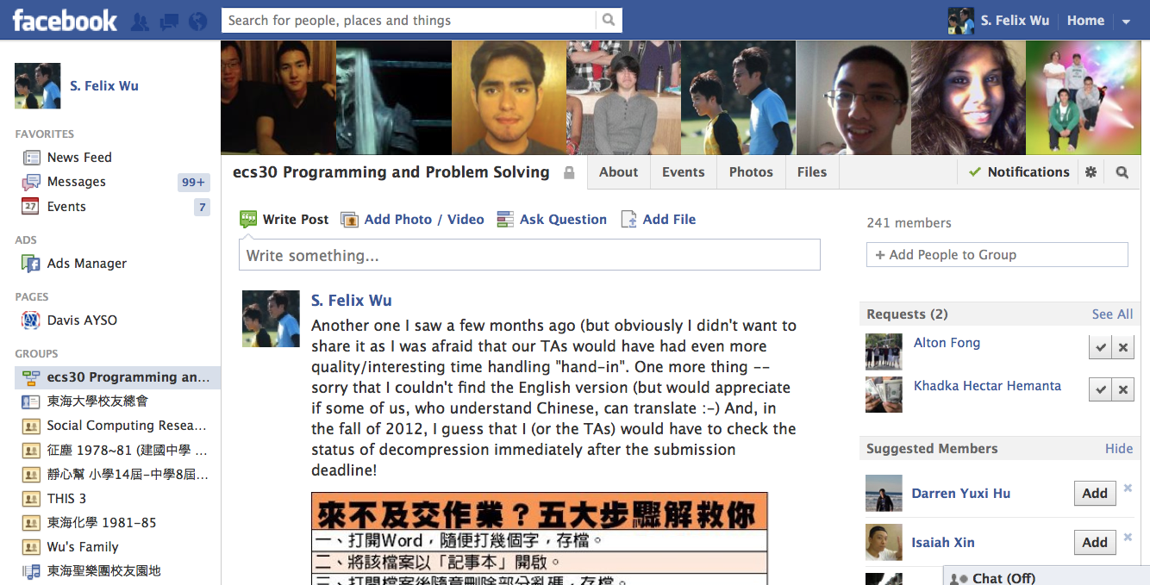
A popular abstraction about each one of us and how we interact with each other.

Slide 25
{"id":"204722549606084_286188574792814","from":{"name":"Alex Klein", "id": "1128308287"}, "to":{"data":[{"version":1,"name":"ecs30 Programming and Problem Solving","id":"204722549606084"}]},"message":"Not sure if already posted, but oh well. :)","actions":[{"name":"Comment","link":"http:\/\/www.facebook.com\/204722549606084\/posts\/286188574792814"},{"name":"Like","link":"http:\/\/www.facebook.com\/204722549606084\/posts\/286188574792814"}], "type":"status", "created_time":"2012-04-12T08:07:28+0000","updated_time":"2012-04-18T14:04:32+0000","comments":{"data":[{"id": "204722549606084_286188574792814_287338651344473”,"from":{"name":"Charles Paulekas","id":"100001547415276"},"message":"lol that's literally one of the first pictures posted here.","created_time":"2012-04-14T05:06:10+0000","likes":1},{"id":"204722549606084_286188574792814_287391658005839","from":{"name":"Alex Klein","id":"1128308287"},"message":"Oh, right. He said \"you'll understand this later\" or something. x.x","created_time":"2012-04-14T08:33:08+0000"},{"id":"204722549606084_286188574792814_291513364260335","from":{"name":"S. Felix Wu","id":"581205756"},"message":"And, this one is \"only for 32 bits pointers\".","created_time":"2012-04-18T14:04:32+0000"}],"count":3}}
An object-oriented realization of our interactions, leveraging JSON and other tools

Slide 26
{"id":"204722549606084_286188574792814",
P[“id”] = "204722549606084_286188574792814”;

Slide 27
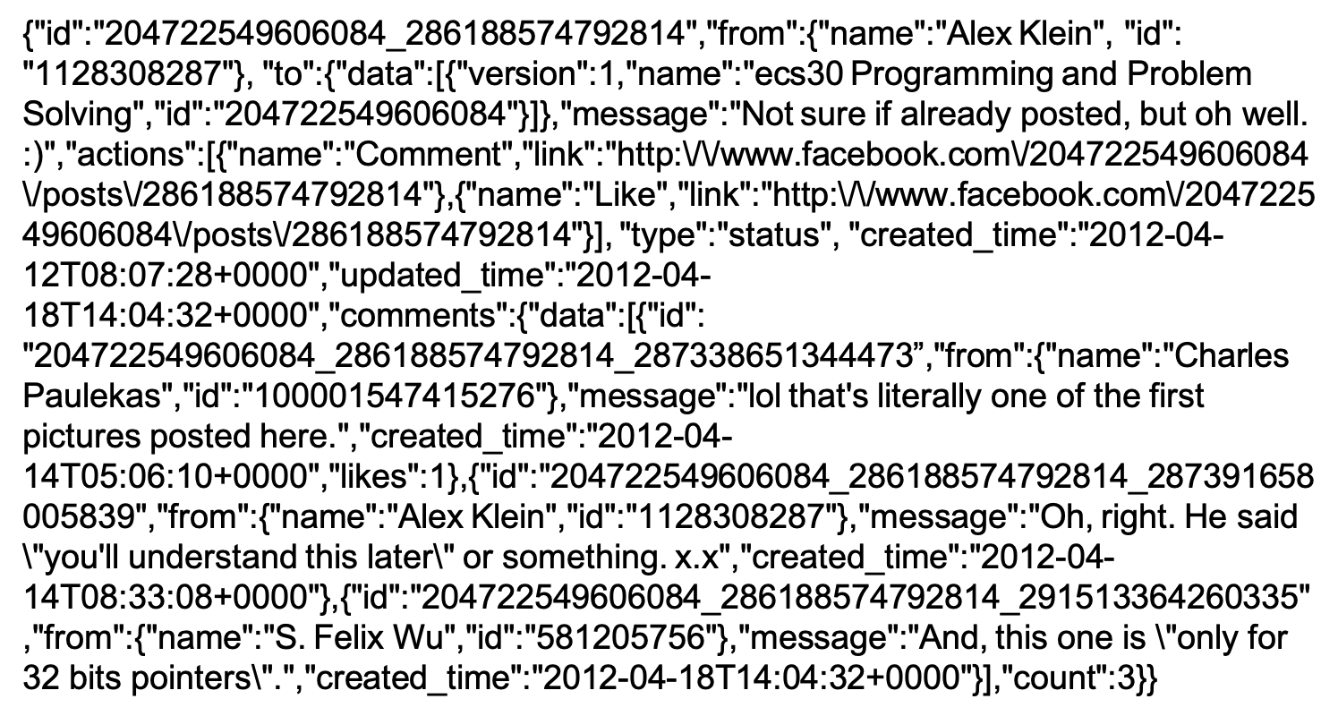

Slide 28
OO Principles
Data Abstraction
Polymorphism
Inheritance
Encapsulation
class person {…}

Slide 29
Objects/Classes
Data/attributes
Internal, external, inherited/protected
Methods (interface)
External, internal, inherited/protected, virtual
Class ~ generalization of Objects with the same “interfaces”

Slide 30
An Object
Integrity/Protection
Reusability
Abstraction

Slide 31
An Object
Integrity/Protection
Reusability
Abstraction

Slide 32
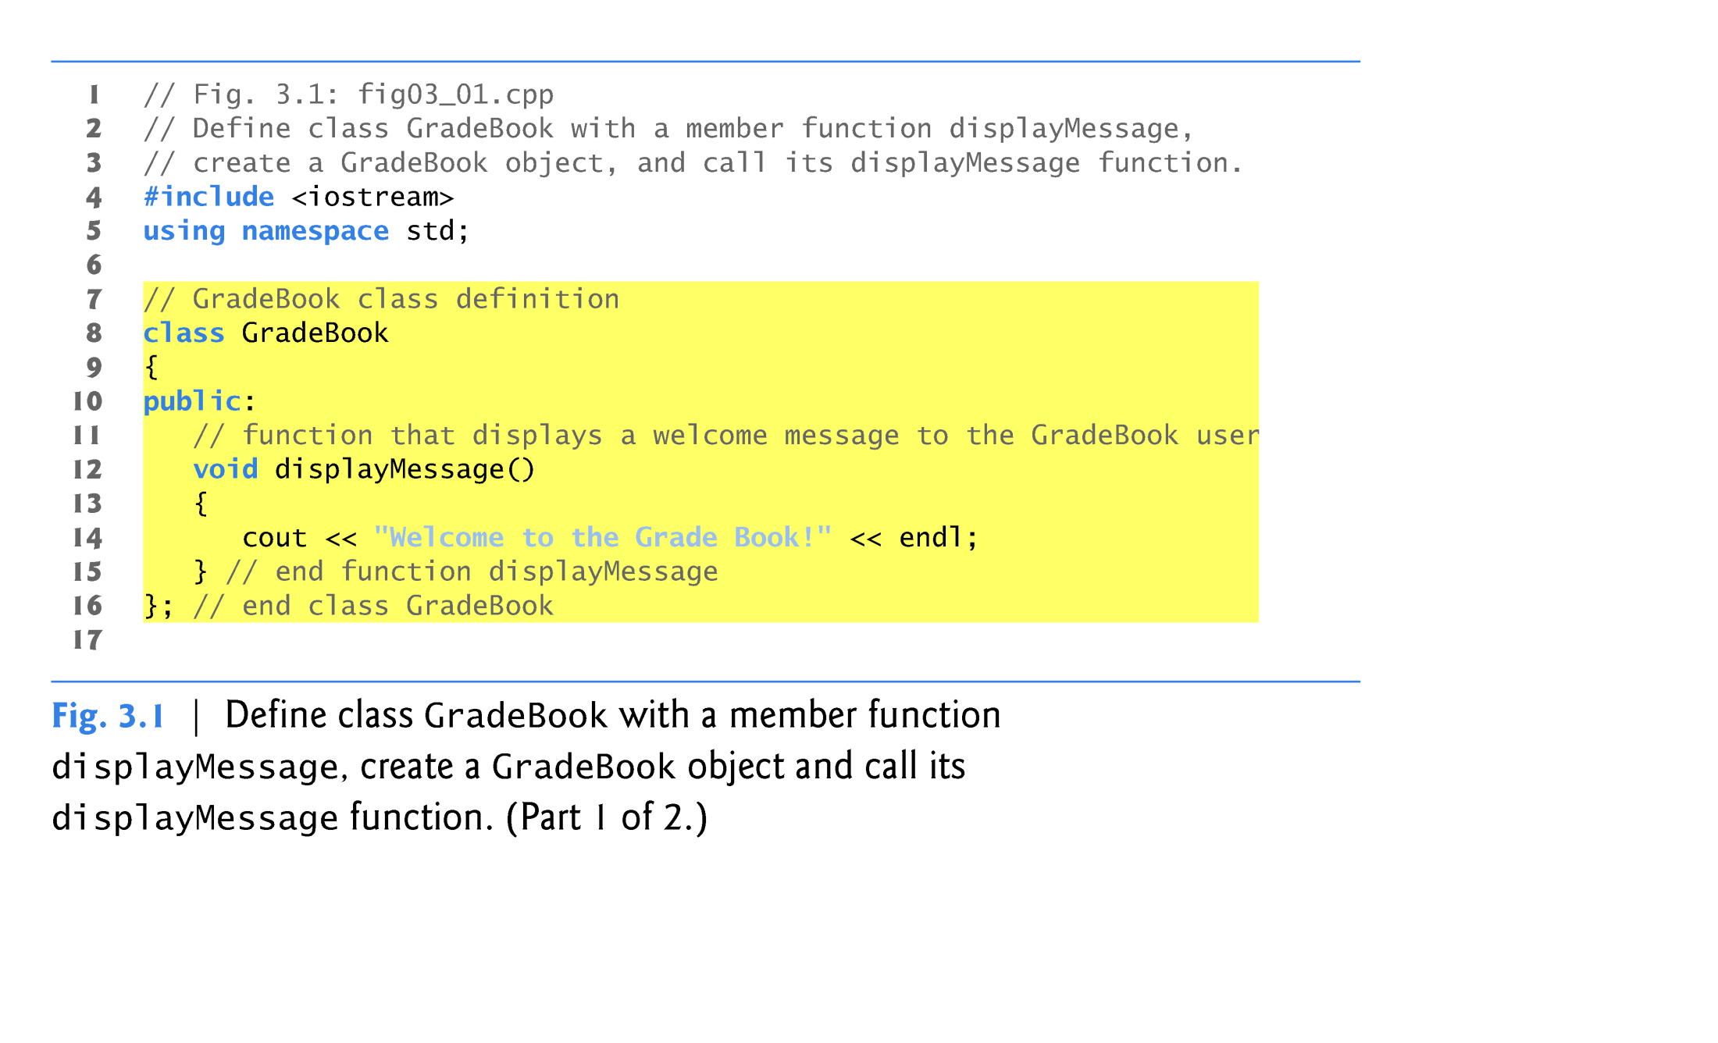

Slide 33
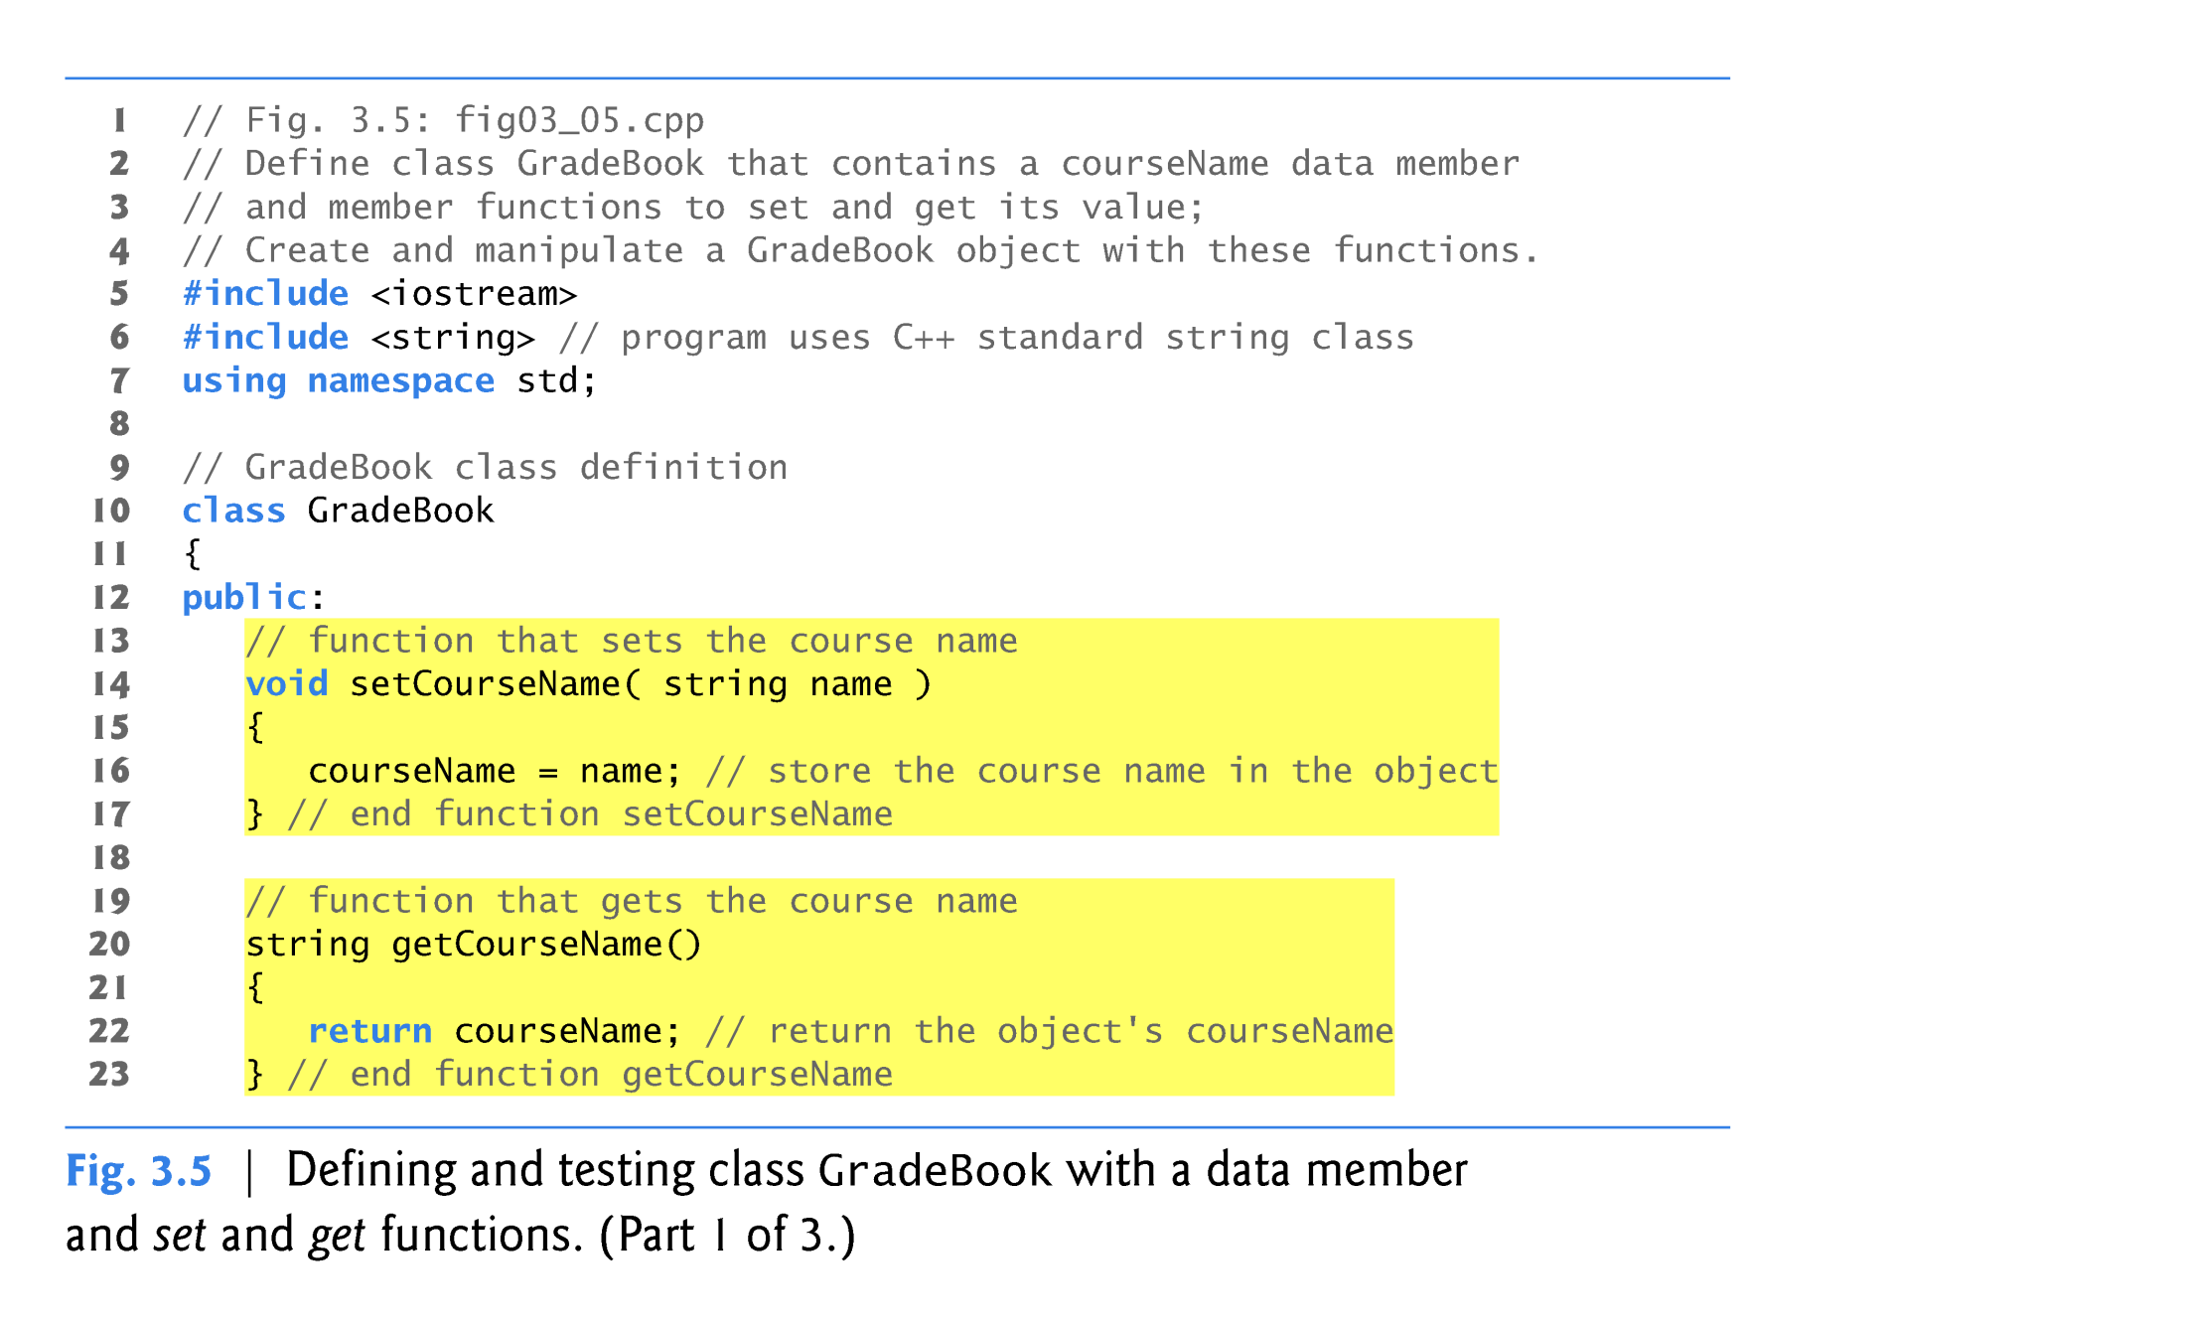

Slide 34
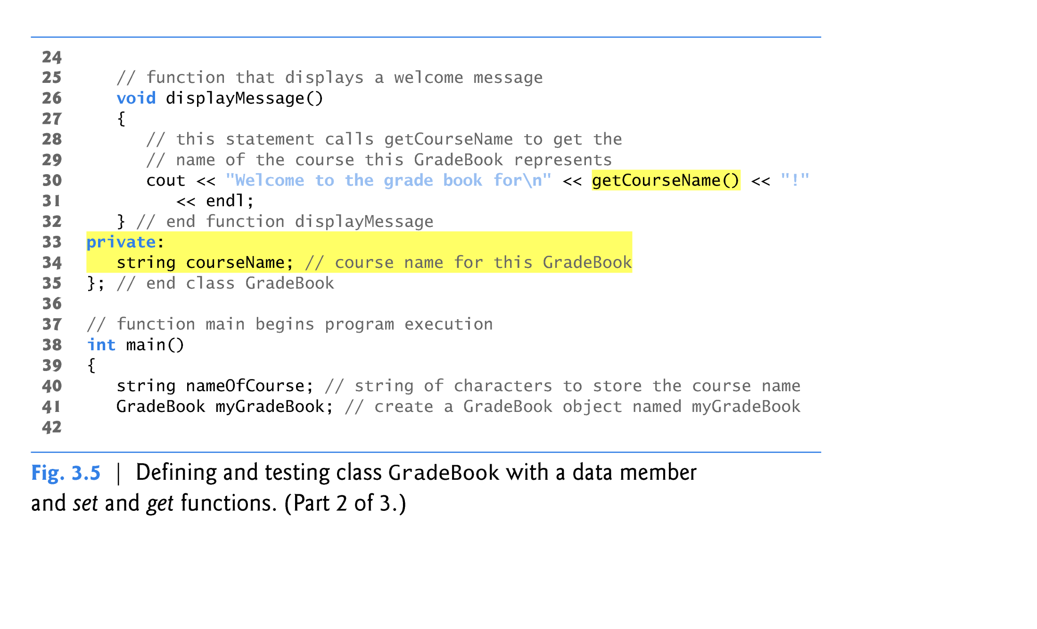
GradeBook
setCourseName
string
getCourseName
displayMessage
Course name
ecs40 Fall 2012 Lecture #01
34

Slide 35

Class/Objects
class user
char *name;
char *student_id;
char *user_id;
URL *profile_photo;
class work_experience;

Slide 36
Two sides of OO*
Complexity of the Problem itself
Choosing the right-level of abstraction
Solving real problems!!
If you haven’t written the program, you don’t know what you are talking about!
Better Software Development

